Slide 1
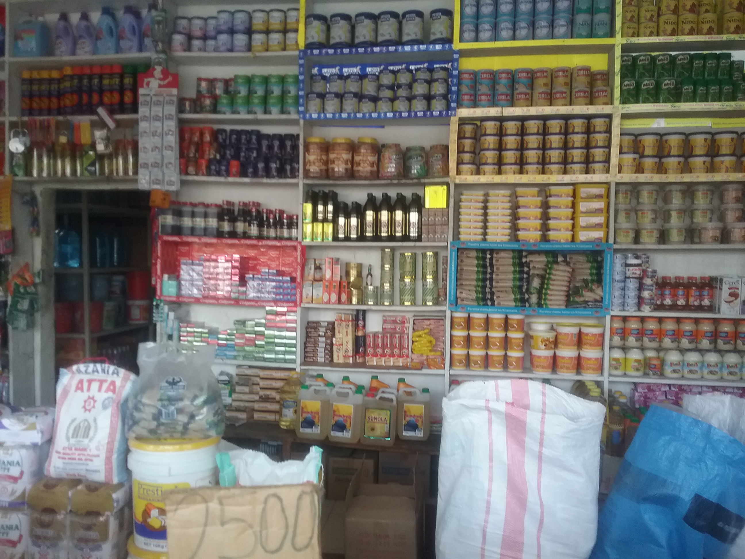
Pandemic effects on Diets and Nutrition Women’s Christian College, Chennai India
Dr .Ramya Ambikapathi
Department of Public Health
Purdue University
September 7, 2020
Notes:
Hello all, thank you for this opportunity to present an overview of the pandemic effects on diet and nutrition. I am really thrilled to be here.

Slide 2
Key messages
Drastic “shock” to way of life so food consumption, diets, and the broader food system at all levels are affected.
The use of a gender lens is important as we evaluate and reduce the negative impact of pandemic.
Differential impacts by inequities even within a same geographic location make policy challenging.
Notes:
I am going to give you key messages of this talk and then show you data/graphics for each of these message.
individual, household, community, regional and national level are all affected
Increased poverty and consequently, wasting, obesity, mental health illness>>> Women, children, marginalized groups are at the center of all these issues

Slide 3
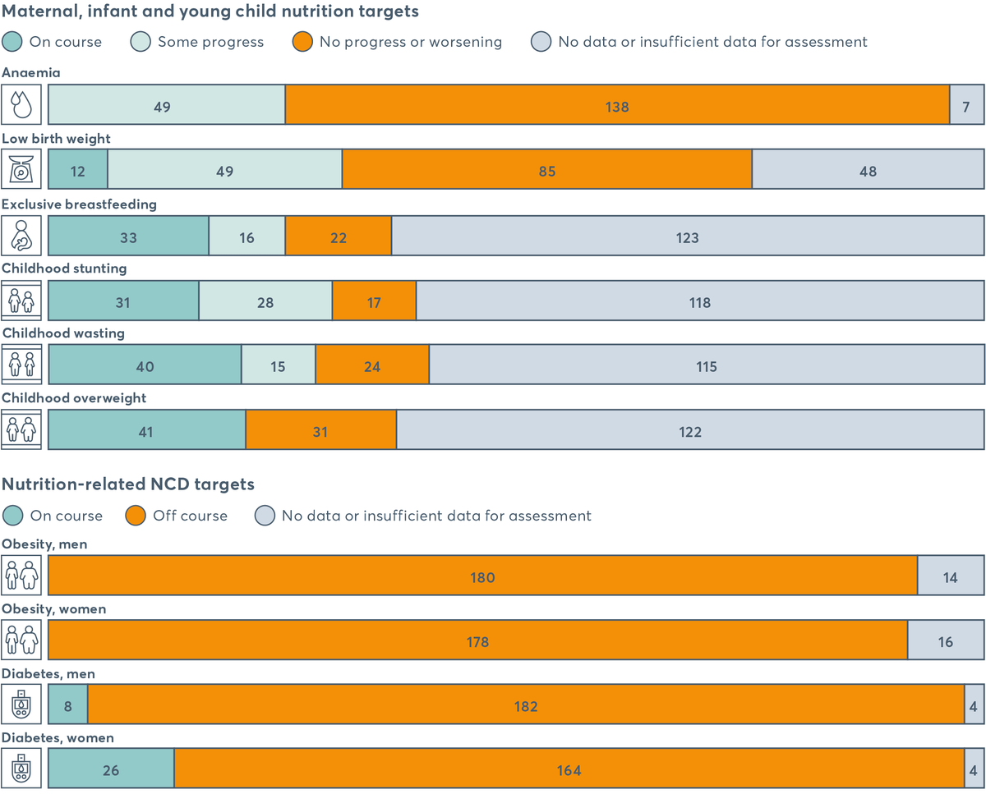
Current status (Global nutrition report, 2020)
Notes:
If you look at the nutrition related non-communicable diseases.

Slide 4
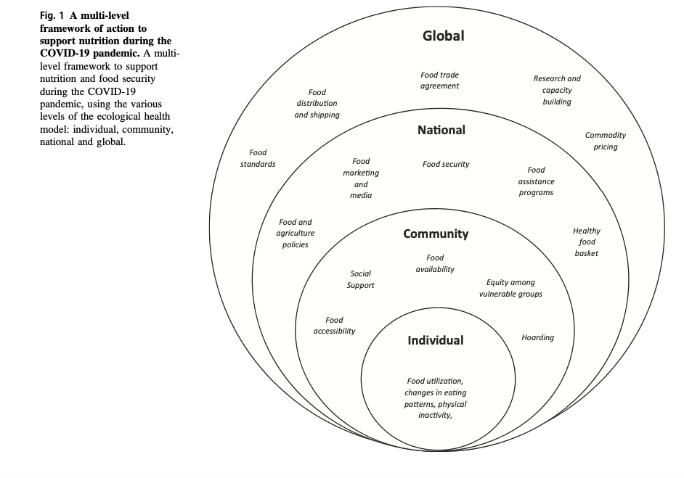
IMPACT on Nutrition at different levels
“The nutritional status of individuals has for long been considered as an indicator of resilience against destabilization”
Naja and Hemadeh, 2020
Notes:
“In fact, poor diet quality has been associated not only with physical but also mental health”
“Nutritional defi- ciencies of energy, protein, and specific micronutrients are associated with depressed immune function and increased susceptibility to infection. An adequate intake of iron, zinc, and vitamins A, E, B6, and B12 is predominantly vital for the maintenance of immune function”

Slide 5
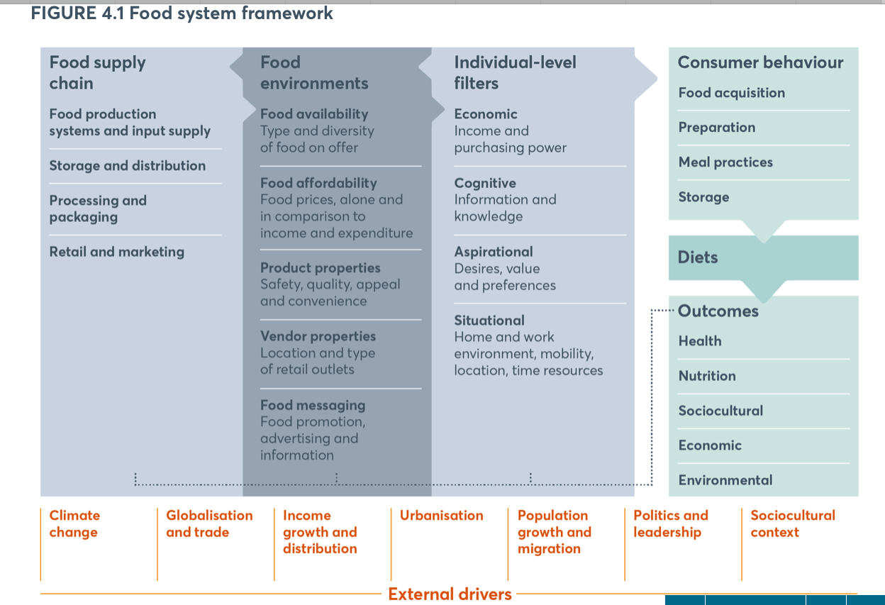
Food systems (Global Nutrition Report, 2020)
80% of folks in SE Asia and Africa rely on purchased foods

Slide 6
Impact on food supply
Photo by Dr.Nilupa Gunaratna

Slide 7
Food systems (Global Nutrition Report, 2020)
80% of folks in SE Asia and Africa rely on purchased foods

Slide 8
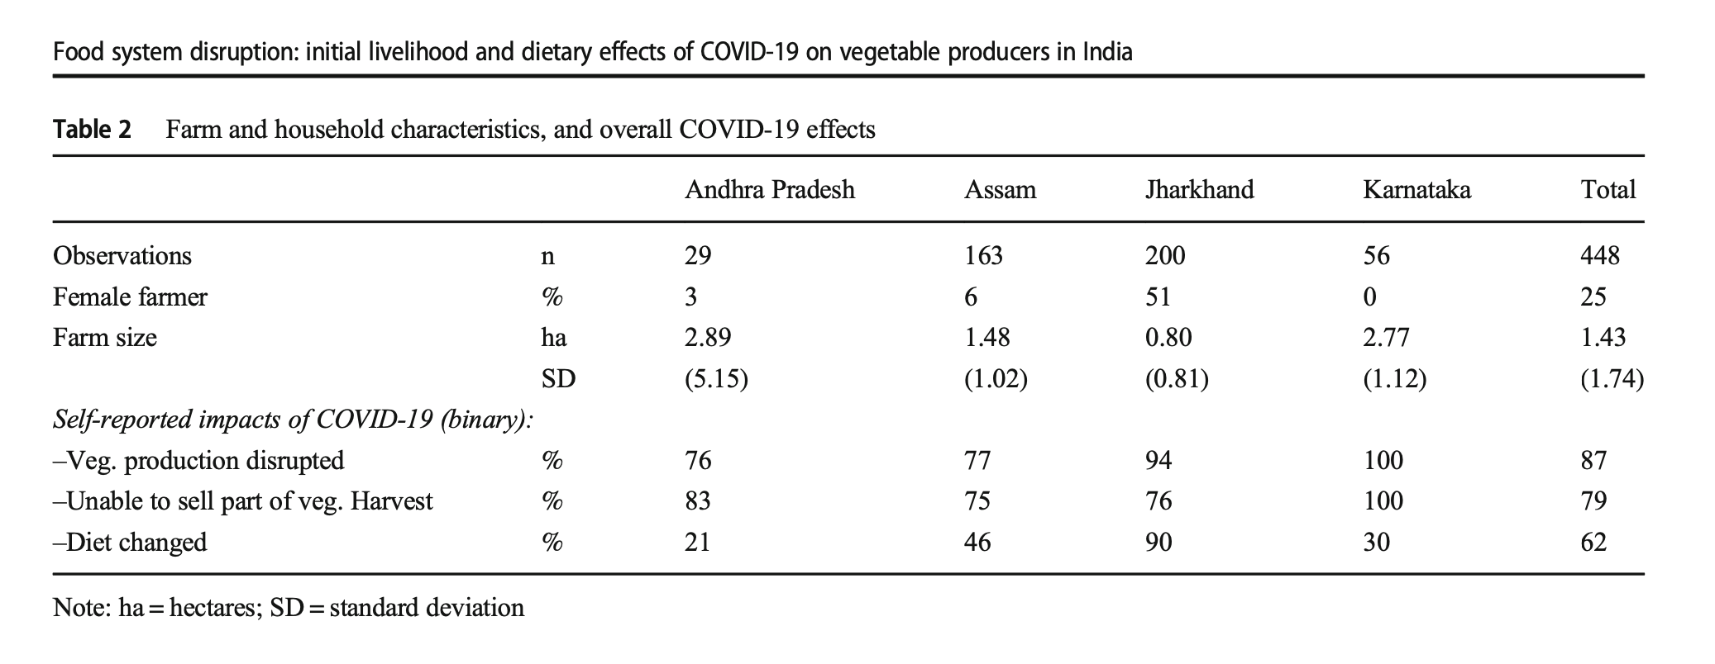
India – Effects on Vegetable supply (sex disaggregated effects) and diets among farmers
Harris et al, 2020

Slide 9
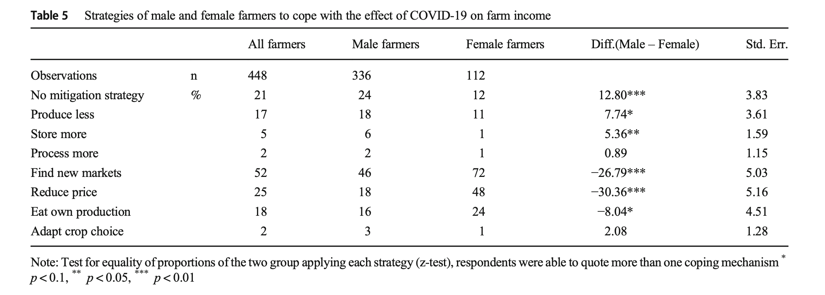
India – Effects on Vegetable farmers
Harris et al, 2020

Slide 10
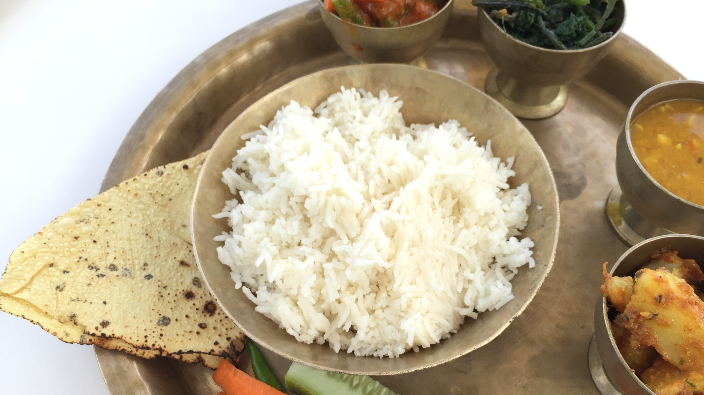
Impact on Diets
Photo taken by me!

Slide 11
Impacts on Diets
80% of folks in SE Asia and Africa rely on purchased foods

Slide 12
Differentiated IMPACTS of Diets IN THE US
School feeding is a global issue, even in the United States.
South Carolina doing “Grab-n-Go” meal sites.
School meals delivered at bus-stops

Slide 13
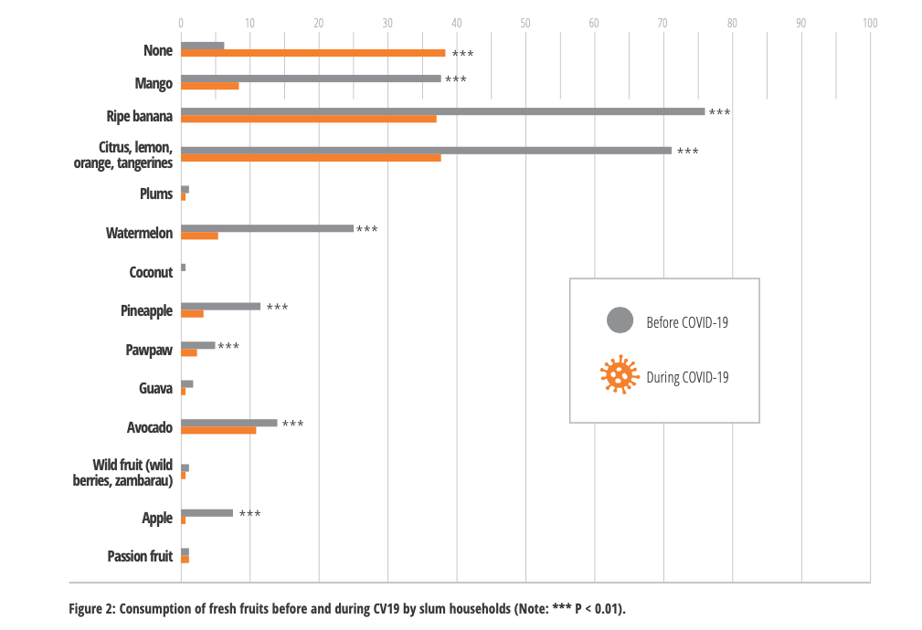
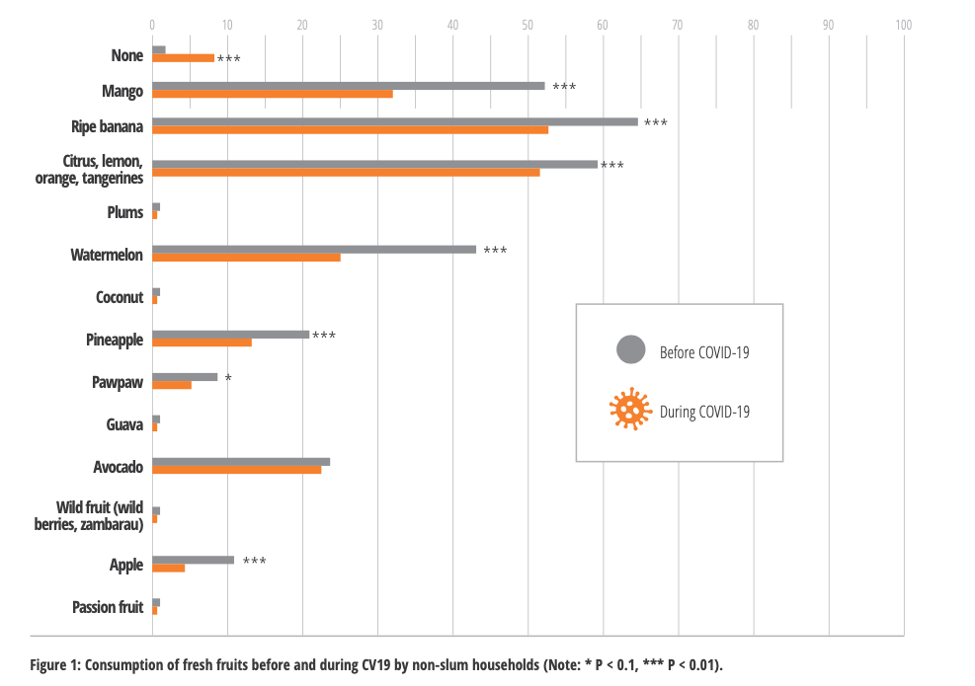
Differential Impact within same city – Nairobi, Kenya
Slum households
Non-Slum households
Impact of COVID-19 on Diets of Poor Consumers in Africa: Evidence from the Slums of Nairobi, Kenya (Chege et al, 2020)
Notes:
Look this is a study in Nairobi during the Pandemic. Demand for nutritious foods – fruits, vegetables, animal source protein.
Two important stories – first difference slum vs non-slum households, then pre and post covid differences. You can see that the impact on slum households, who show greater vulnerabilities.

Slide 14
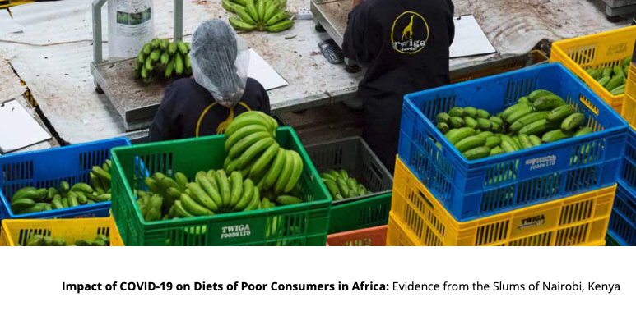
Differentiated Policy response even within one city: Nairobi, Kenya
“First, the voices of the poor need to be considered during formulation of policies.
However, for the slum households, interventions to reduce food prices during such a pandemic like COVID-19 will not necessarily guarantee improved food security and nutrition.
For this consumer group, strategies and interventions to improve their incomes empowerment to access nutritious foods.
Once they are empowered economically, a second intervention would be towards lowering food prices.”
Impact of COVID-19 on Diets of Poor Consumers in Africa: Evidence from the Slums of Nairobi, Kenya (Chege et al, 2020)

Slide 15
Impact on nutritional status
Photo taken by me!

Slide 16
Impact on Nutritional outcomes
80% of folks in SE Asia and Africa rely on purchased foods

Slide 17
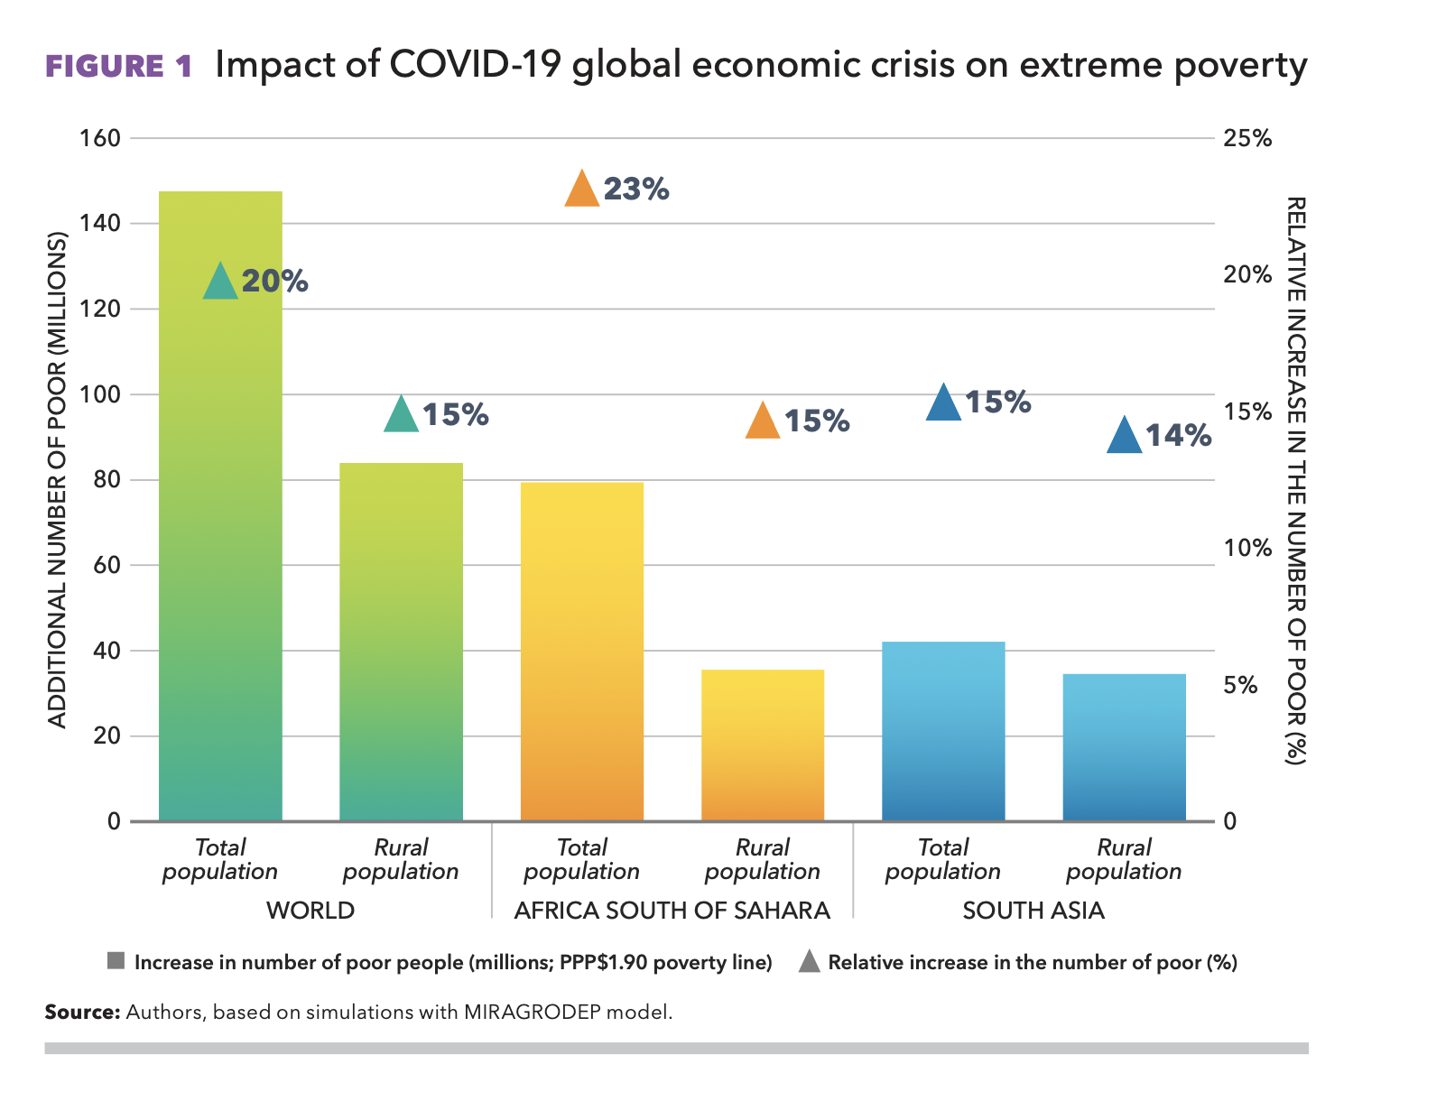
COVID-19 & GLOBAL FOOD SECURITY DOI: https://doi.org/10.2499/p15738coll2.133762
Notes:
Biggest driver of poor nutrition and health outcomes is poverty. In this plot, looking at covid19 impacts, we see that extreme poverty will increase by 20% -- a bit lower in rural population. So this puts us back in 1990s.

Slide 18
Impact on under-nutrition and over-Nutrition
(Headey et al, 2020)
Before pandemic: 47 million children under 5 were moderately or severely wasted. (Headey et al, 2020); With the pandemic:
Wasting is estimated to increase 15%
Access to nutrition and health care services – early pandemic, it was 30% and in lockdown, its estimated 75-100%. (Growth monitoring, vitamin A supplementation)
Sedentary activities with lockdown
Screen time and obesity
Reduced physical activity
Notes:
Wasting expected to increase by 15% with the pandemic

Slide 19
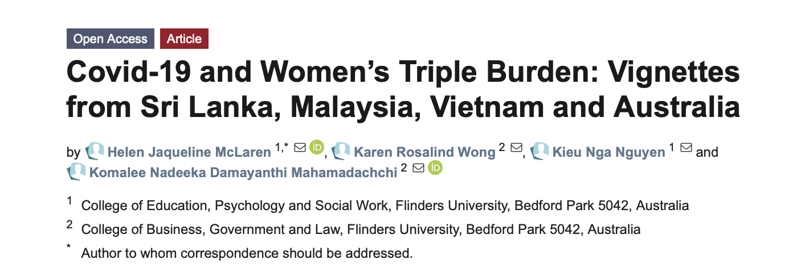
Impact on women and consequently, nutrition

Slide 20
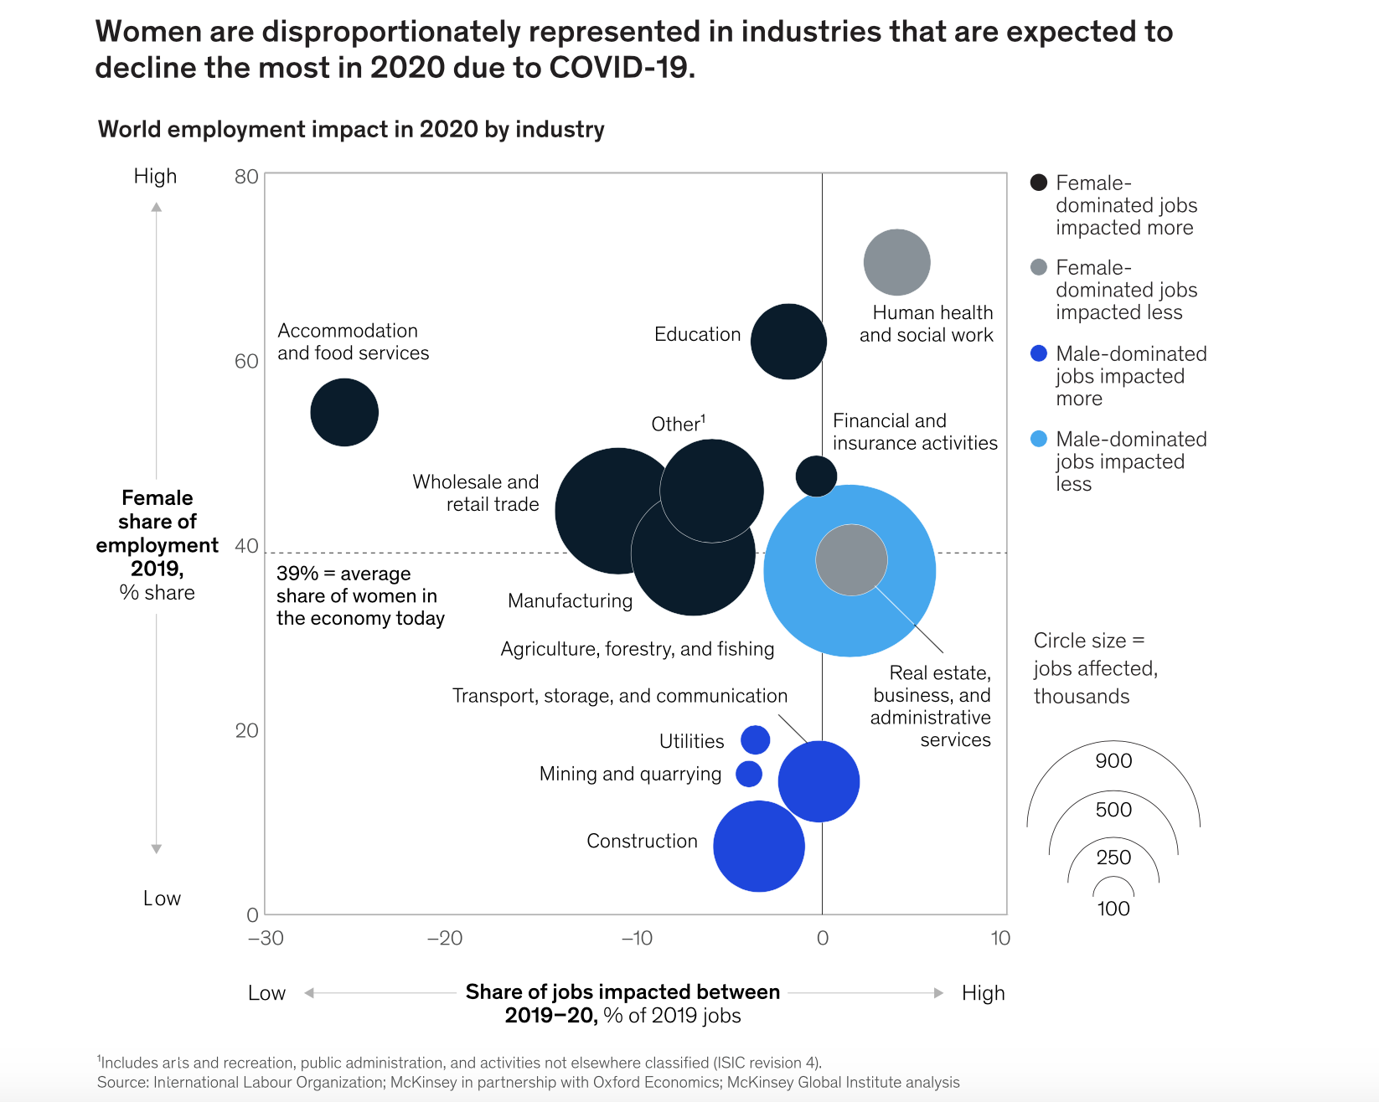
Women are more impacted in industries that were affected the most by covid-19
https://www.mckinsey.com/featured-insights/future-of-work/covid-19-and-gender-equality-countering-the-regressive-effects#

Slide 21
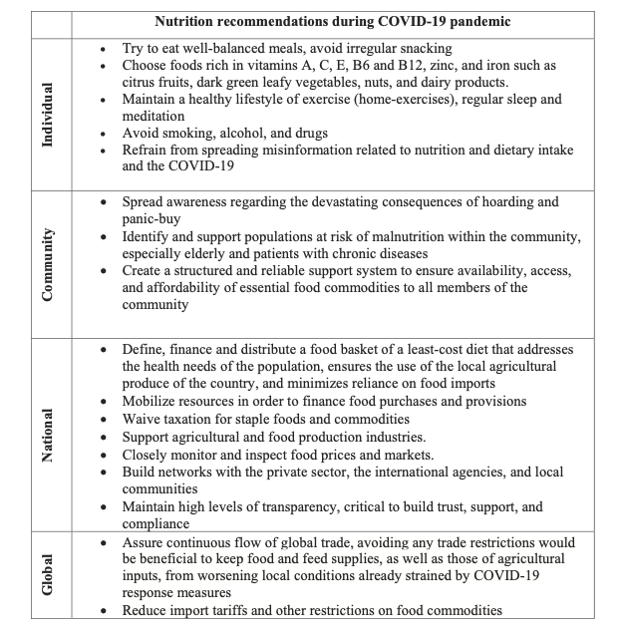
Nutrition recommendations at different levels
“Since the outbreak, networks of social media were flooded by messages of single foods/herbs promising cure or prevention of the infection. The effects of such unfounded claims could lead to negative implications ranging from giving a false sense of protection against the infection to toxicity”
Naja and Hemadeh, 2020
Reduce communication cost (cell phones, internet, etc)

Slide 22
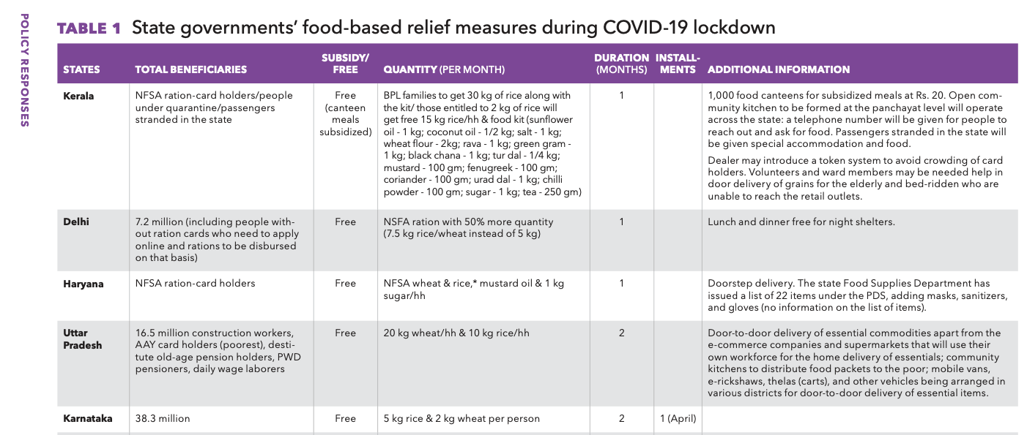
Regional response to food insecurity In India
http://ebrary.ifpri.org/utils/getfile/collection/p15738coll2/id/133762/filename/133971.pdf
Notes:
http://ebrary.ifpri.org/utils/getfile/collection/p15738coll2/id/133762/filename/133971.pdf

Slide 23
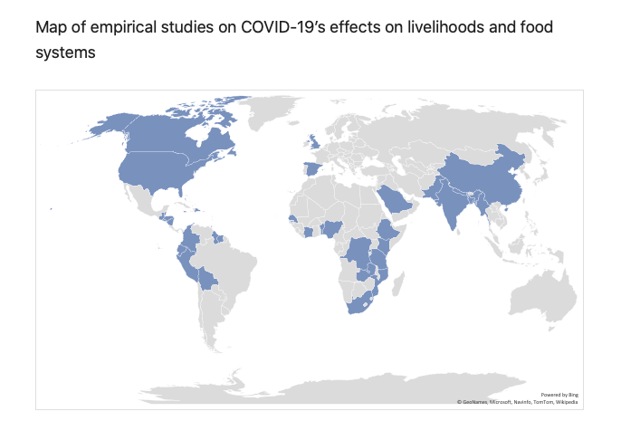
Mapping studies across the world conducted during the pandemic
Almost all studies are telephone or online surveys (so sampling and results should be interpreted with caution).
Not many papers show sex-disaggregated data.
Some issues of doing cellphone surveys; men listening in/confidentiality issues; phones cut off as extra expenses
https://ramyaambikapathi.com/mapping-empirical-evidence-of-covid-19s-effect-on-food-systems/
https://pim.cgiar.org/2020/07/14/phone-surveys-to-understand-gendered-impacts-of-covid-19-a-cautionary-note/

Slide 24
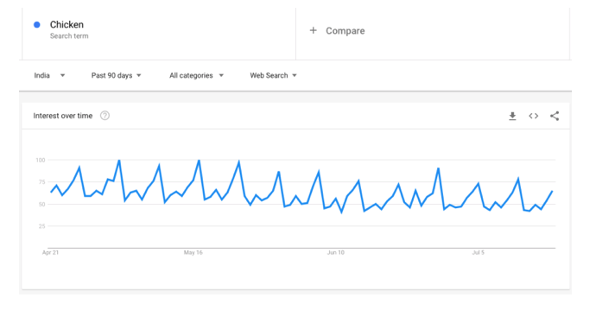
What can you as students do?
http://poshan.ifpri.info/upcoming-events-2/
Discuss,
Attend webinars,
Track things,
Blog,
Photography stories,
Be vocal,
Engage in advocacy.
https://ramyaambikapathi.com/using-google-trends-to-examine-food-related-behaviors-and-concerns-under-covid-19/

Slide 25
Key messages
Drastic “shock” to way of life so food consumption, diets, and the broader food system at all levels are affected.
The use of a gender lens is important as we evaluate and reduce the negative impact of pandemic.
Differential impacts by inequities even within a same geographic location make policy challenging.
Notes:
I am going to give you key messages of this talk and then show you data/graphics for each of these message.
individual, household, community, regional and national level are all affected
Increased poverty and consequently, wasting, obesity, mental health illness>>> Women, children, marginalized groups are at the center of all these issues

Slide 26
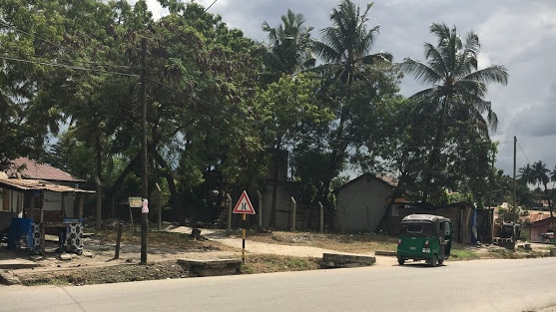
Thank you!
Questions/Comments, please contact me at rambikap@purdue.edu
Notes:
Read out first bullet point.
I would like achnowledge my team and the participants for presenting on their behalf and highlighting these finding from their community
And also our funder drivers of food choice for making this possible.

Slide 27
Extra slides to nix

Slide 28
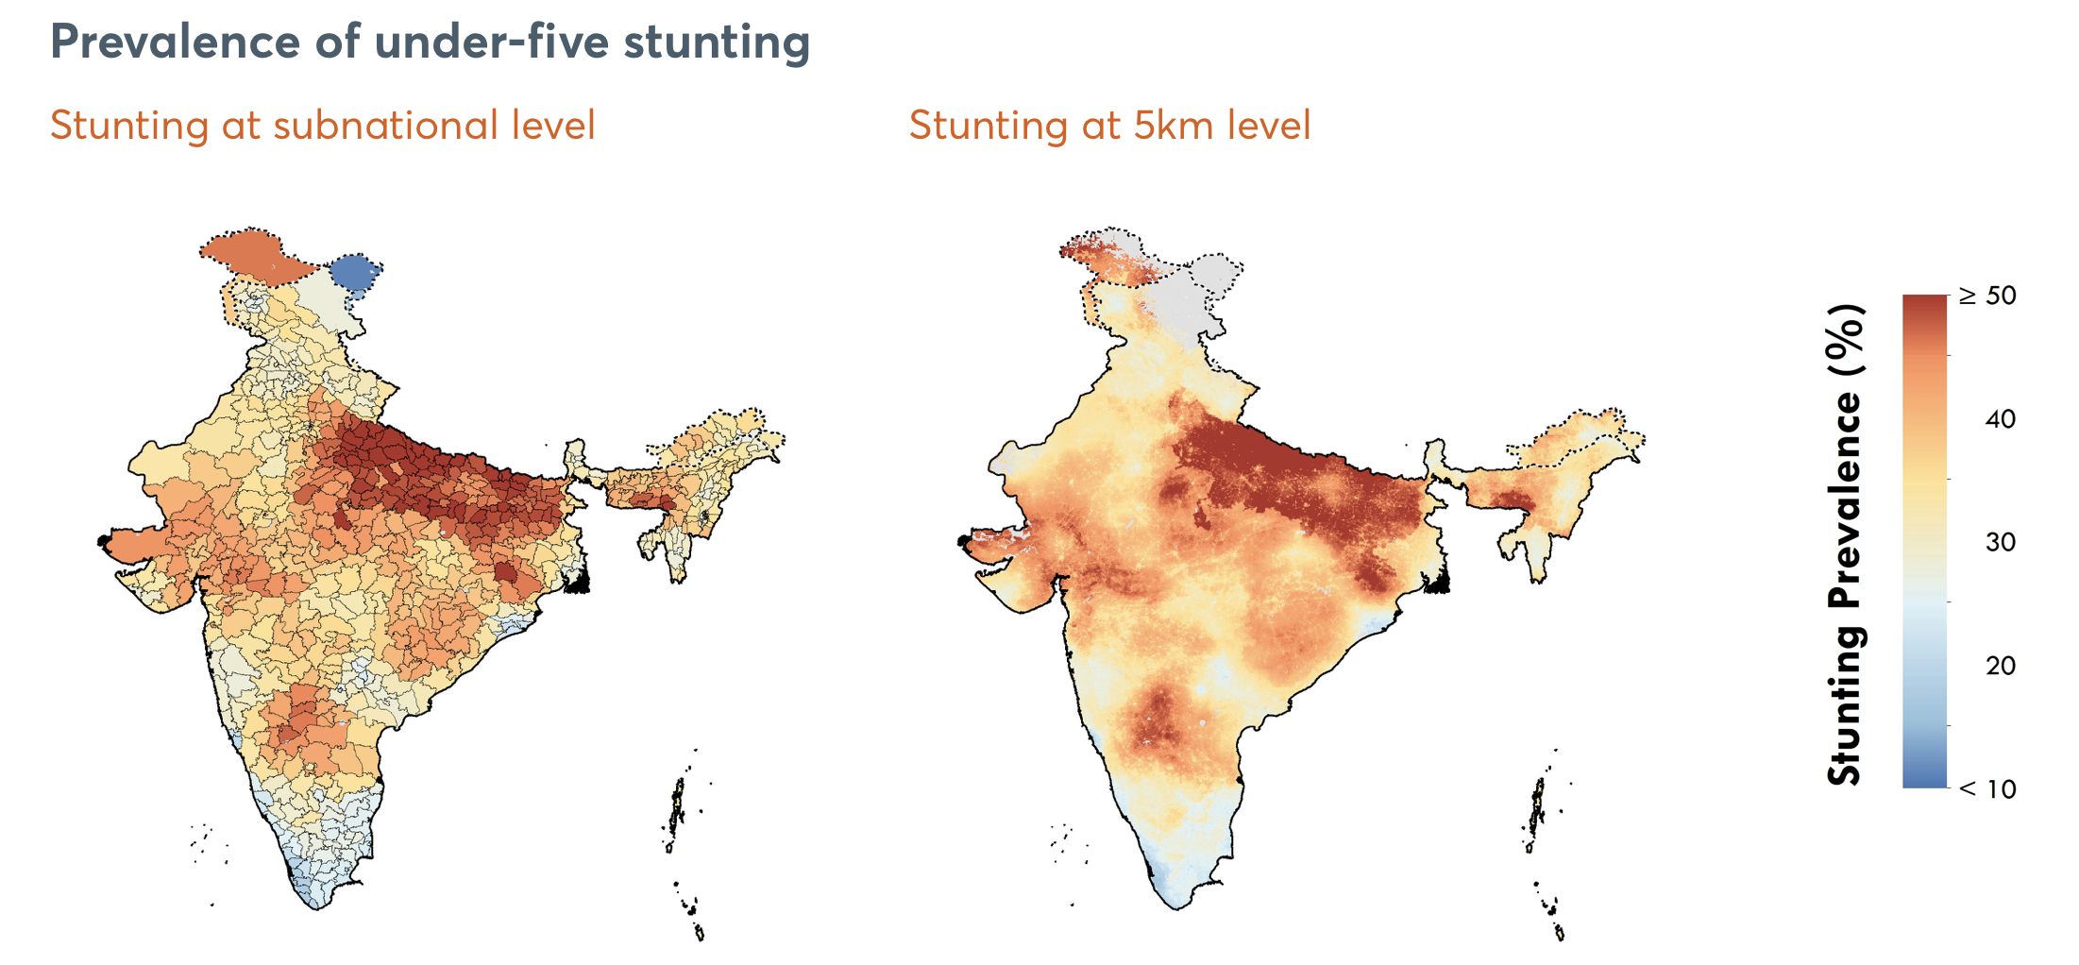
Global nutrition report – INDIA country profile, 2020

Slide 29
IMPACT on Nutrition at different levels
“The nutritional status of individuals has for long been considered as an indicator of resilience against destabilization”
Naja and Hemadeh, 2020
Notes:
“In fact, poor diet quality has been associated not only with physical but also mental health”
“Nutritional defi- ciencies of energy, protein, and specific micronutrients are associated with depressed immune function and increased susceptibility to infection. An adequate intake of iron, zinc, and vitamins A, E, B6, and B12 is predominantly vital for the maintenance of immune function”

Slide 30
India profile

Slide 31
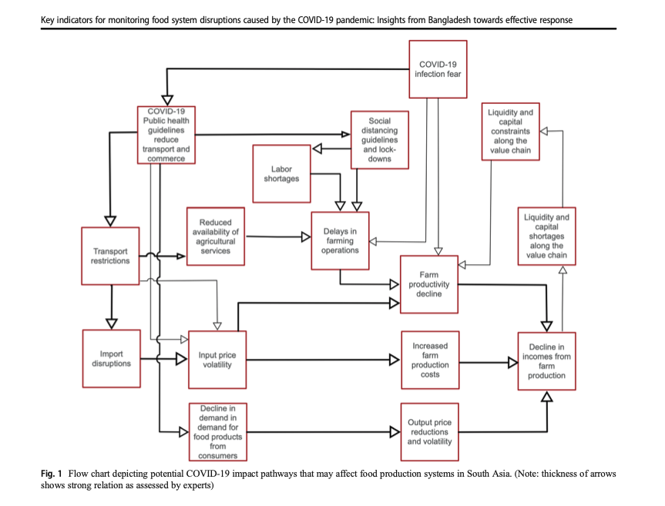
Impact on Food system: Example from Bangaldesh
Amjath-Babu et al, 2020

Slide 32
Impact on Food Security
(Rami, 2020)
Availability | Access | Utilization | Stability
The global food supply chains are currently subjected to disturbances of varying severity. Freight by land and air routes has been seriously disrupted | Panic buying – empty supermarker shelves and increased waste | Shift to shelf stable foods vs nutritious fresh fruits/vegetables | In countries in the Middle East and East Africa, such as Yemen and Somalia, the combination of conflict, siege, and locust invasion is further destabilizing food security
Trade restrictions on major commodities, especially wheat (Kazakhstan, Russia, and Romania) and rice (Thailand, Cambodia, and India) | Inability for farmers to sell for hotel/resturatn, catering sector led to more wastage and produce dumping | “The triple burden (obesity, malnutrition, and undernutrition) is likely to increase due to the combination of limited access, poor dietary choices, and locked-in dietary habits compounded by less exercise. “ | Countries that rely on oil for the largest part of their export earnings may experience difficulties due to record low oil prices
scrambling to build up their food reserves | Lost of income and employment
Transportaion for agricultural inputs affected (seeds, agrochemicals) and labor shortages | Global price increase
Notes:
“In addition, global food trade has been heavily affected as, in countries like India, ships have had to stay in ports without the ability to move basic staples such as rice (Gulf News, 2020). "

Slide 33
Impacts on Diets: among vegetables farmers in India
Harris et al, 2020

Slide 34
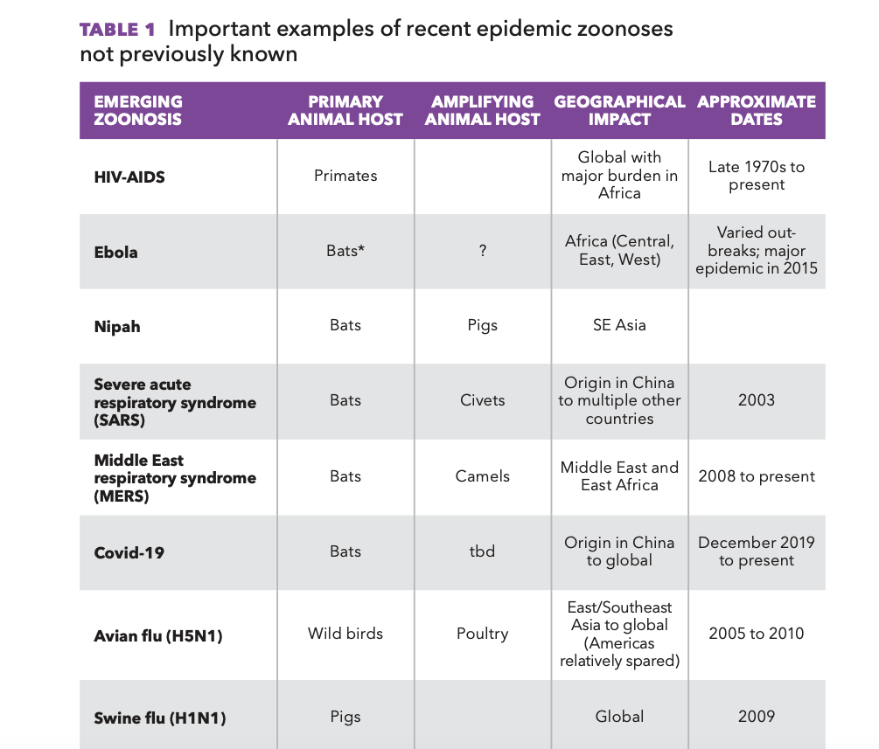
Food safety going to be an important issue for the future of food systems

Slide 35
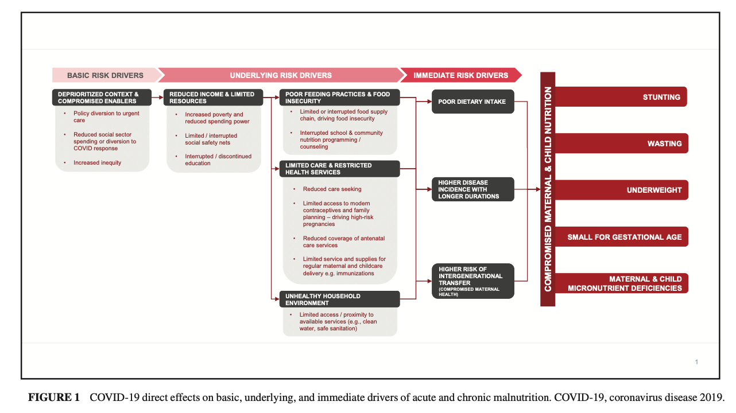
Impact on maternal and child nutrition
(Akseer et al, 2020)

Slide 36
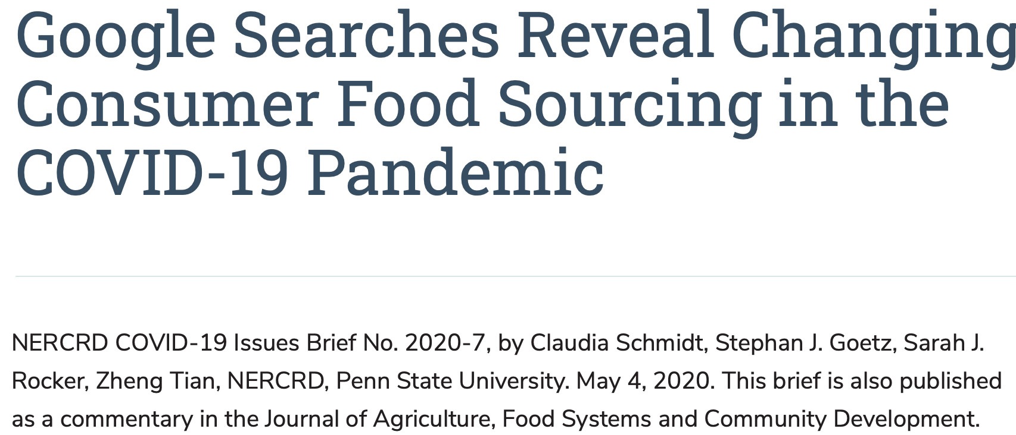
Impact on food sourcing behavior

